Slide 1
THRIFTLIST DATABASE MANAGEMENT SYSTEM
TEAM DATACREW

Slide 2
TEAM DATACREW
ASWATH RANGACHARI
JANANI BALAJI
SHARATH RAVICHANDRAN
SUBBIAH CHERANTHIAN
YAZHINI RAMAKRISHNAN

Slide 3
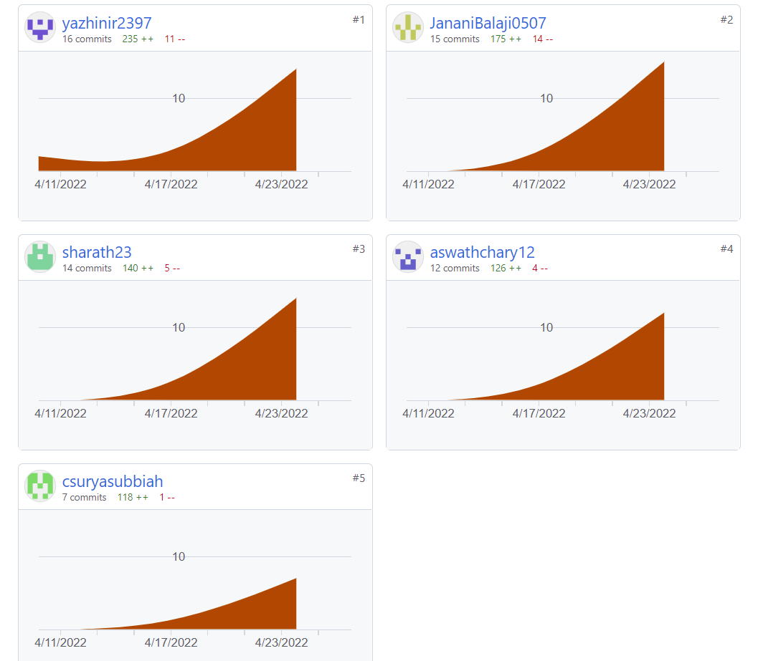

Slide 4
CONTRIBUTIONS
ASWATH RANGACHARI | Seller module, payment module, Dfd-seller management, Payment mode report
JANANI BALAJI | Shipper module, Dfd- shipper management, Shipment status report, seller items report
SHARATH RAVICHANDRAN | Customer module, Dfd-customer management, Customer spend report, city wise spending report
SUBBIAH CHERANTHIAN | Address module, Create access roles-security, Item division view
YAZHINI RAMAKRISHNAN | Order ,item module, Views- item_price_category, Customer_order_history, Item condition report

Slide 5
PROBLEM
Items or things that are intended to throw away can be reused.
There are many walk-in thrift stores available but there is still an online demand for shopping used items.
Other platforms are too general (Amazon) or lack security/payment options (Craigslist)
A website or an online system can store these records and items which are reusable and can be used again by many customers who are interested in buying them at a cheap price.

Slide 6
SOLUTION OVERVIEW
Platform allow use of search for item based on price/ categories
13 different entities + 1 bridge table.
Can keep track of order details with shipment and shipper tables.
01
4 levels of security & users: Admin, Seller, Shipper, Customer
02
03
04
05
Users can sign up as a seller or customer using their Username, Password, Mobile Number, and email.

Slide 7
IMPLEMENTED CONCEPTS
Procedures
Functions
Packages
Views
Triggers
Cursors
Exception handling
Grants
Reports

Slide 8
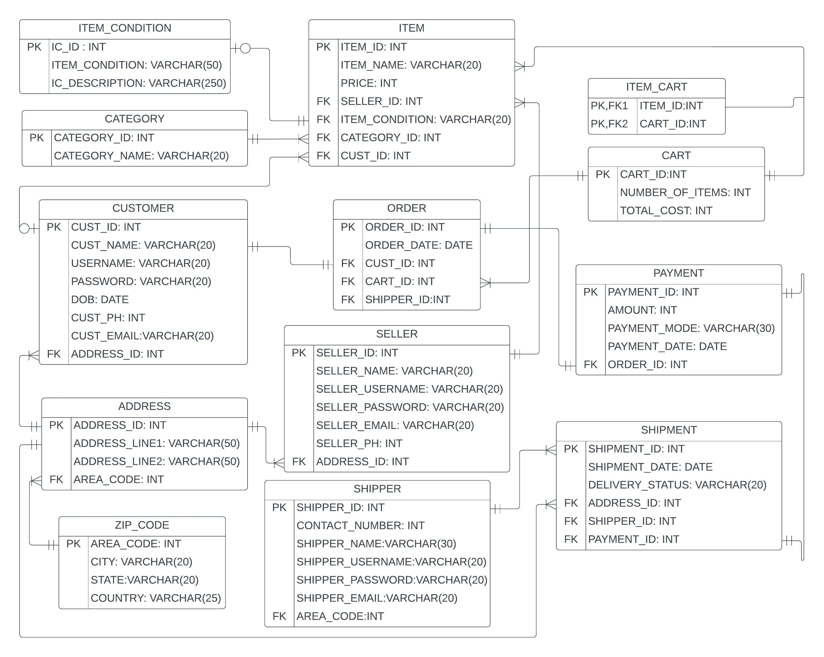
ER
DIAGRAM

Slide 9
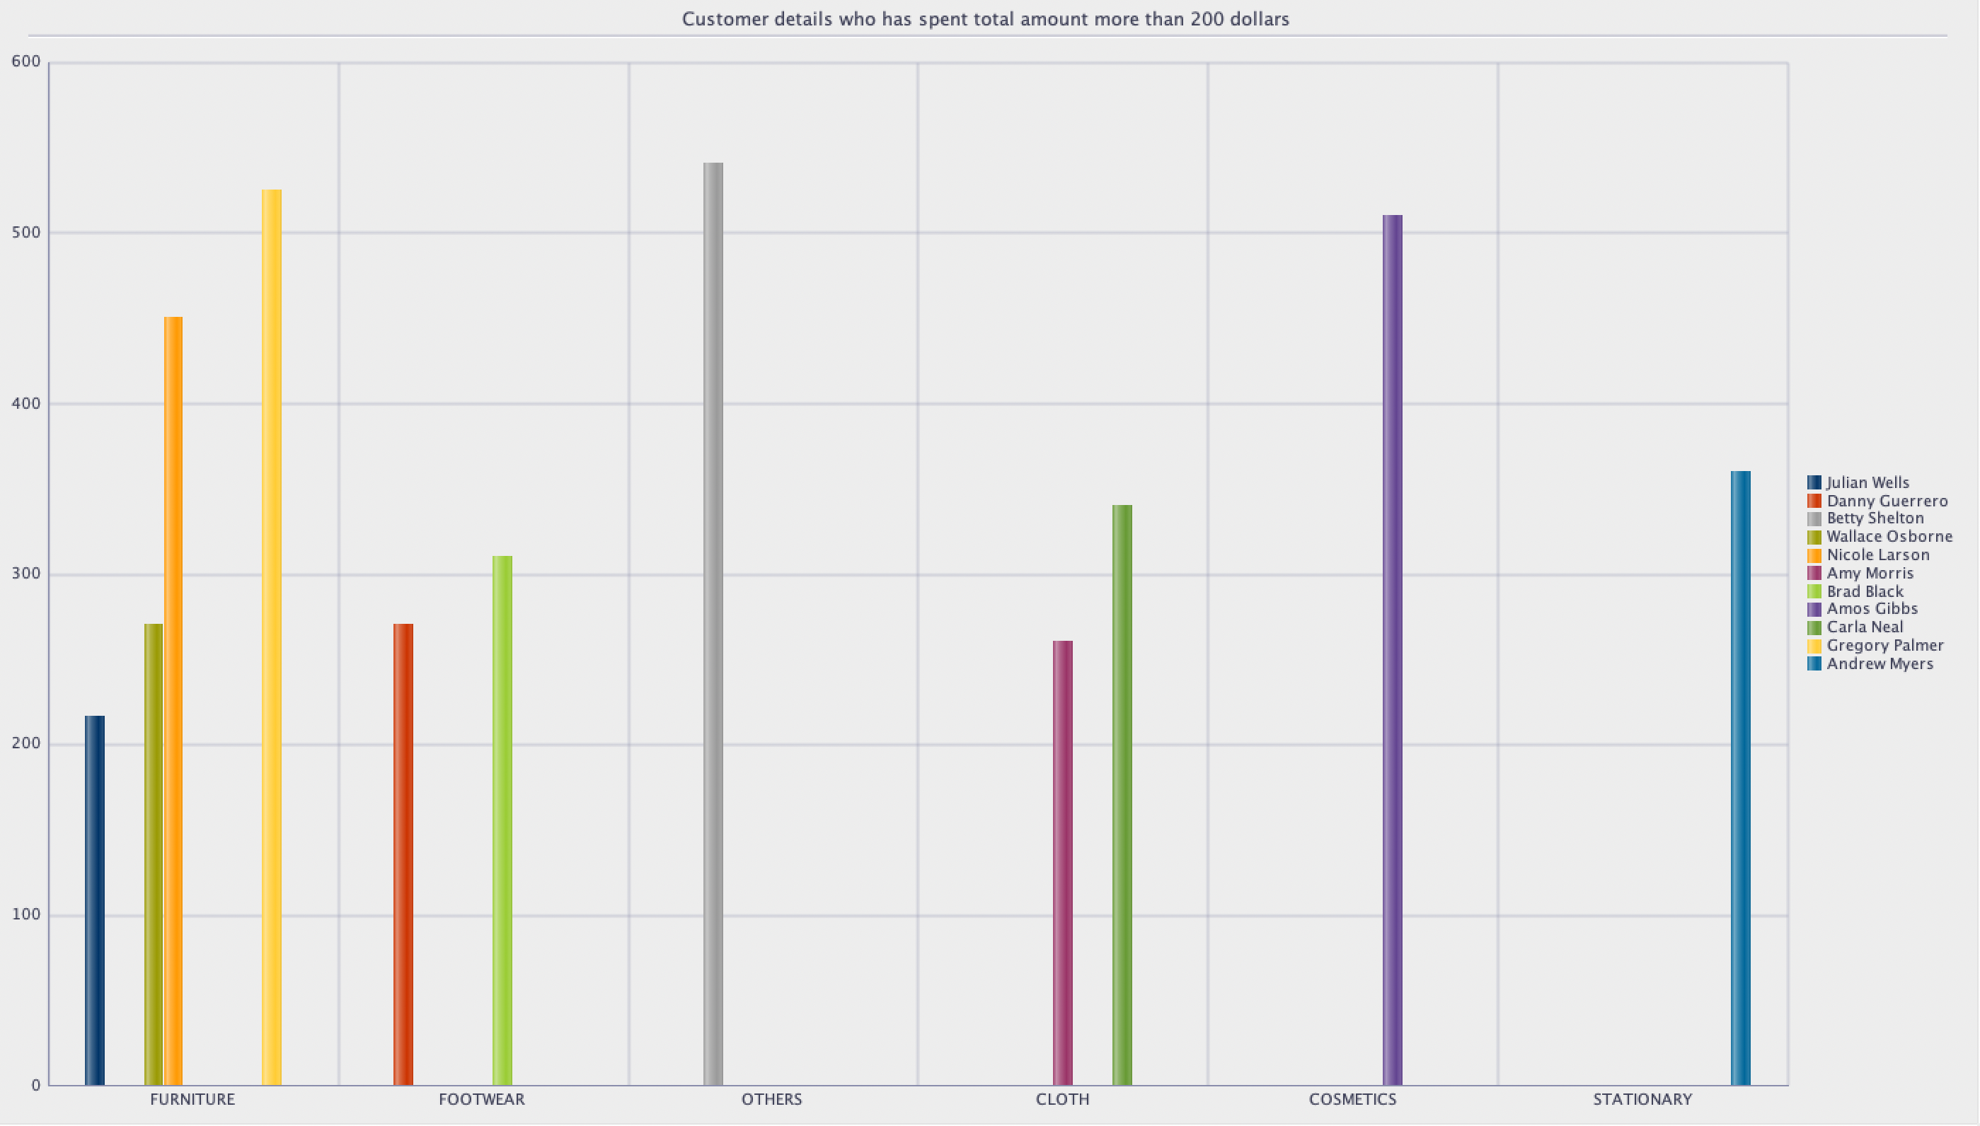
REPORTS

Slide 10
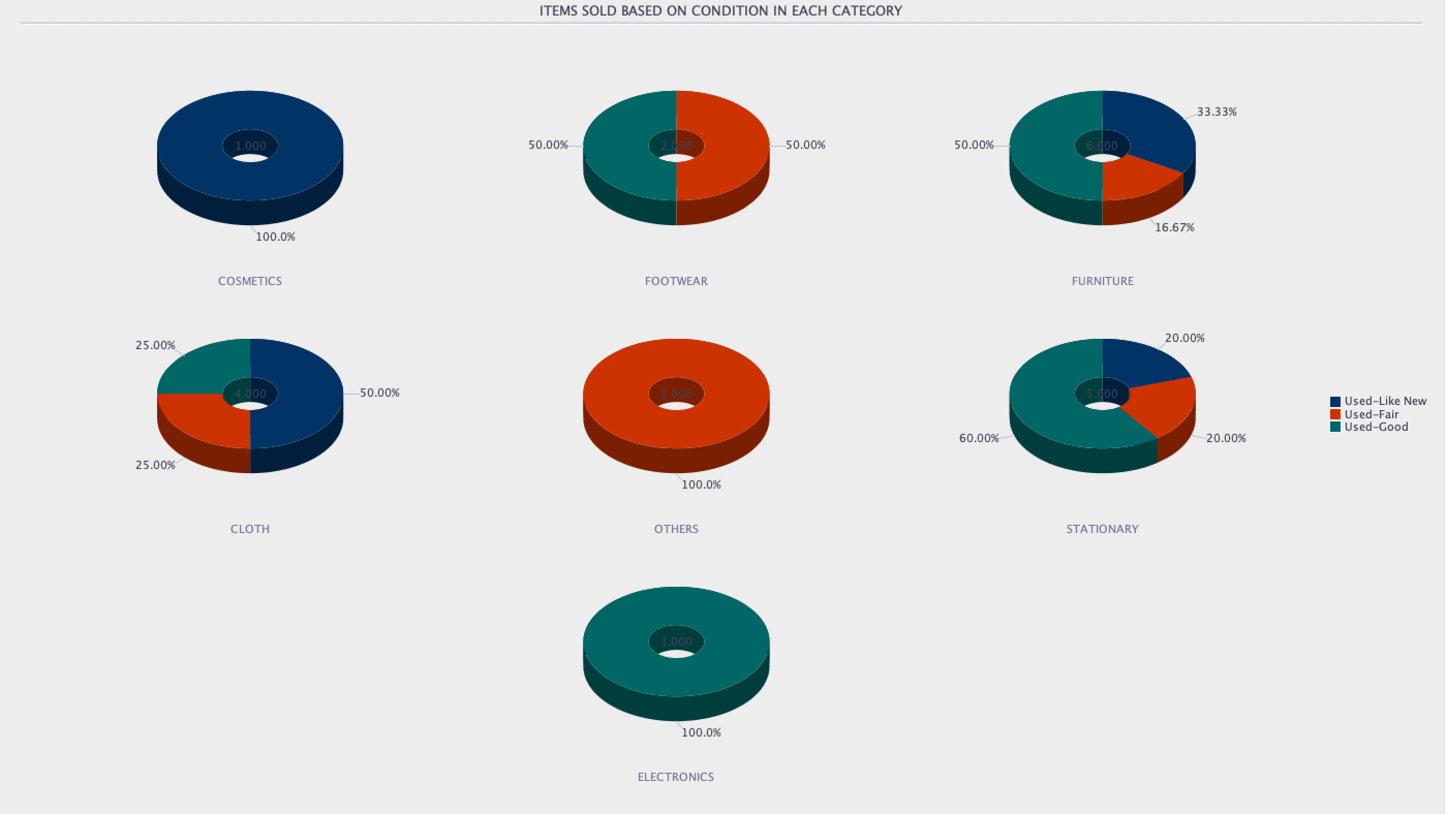
REPORTS

Slide 11
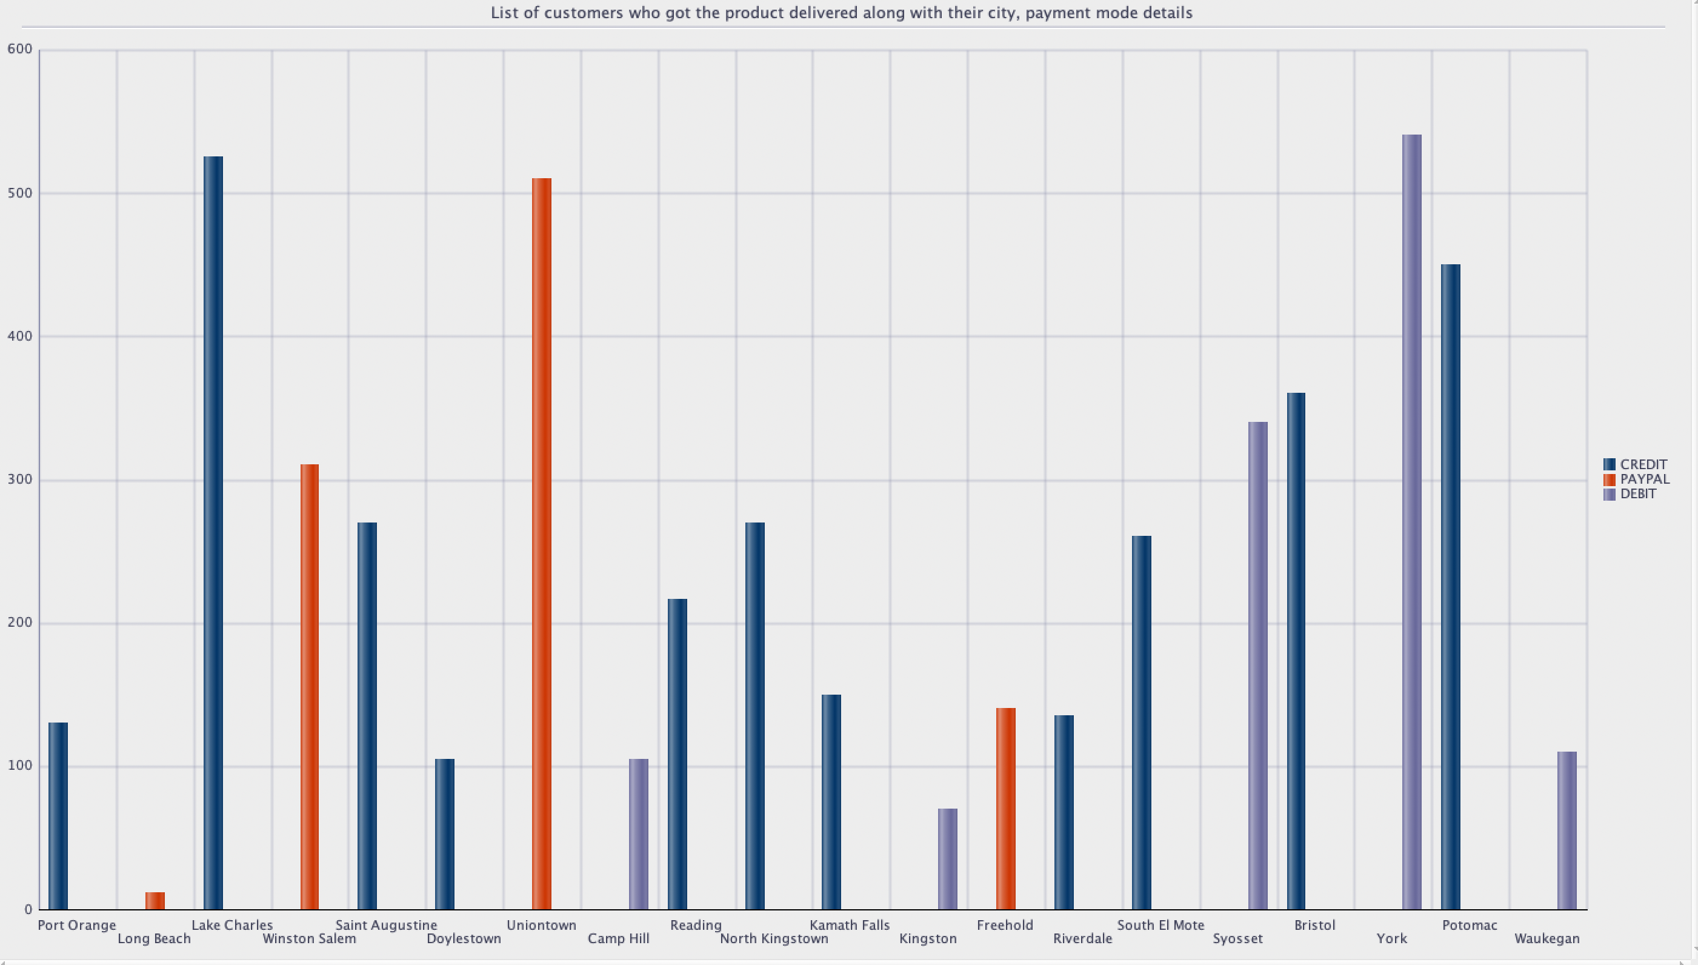
REPORTS

Slide 12
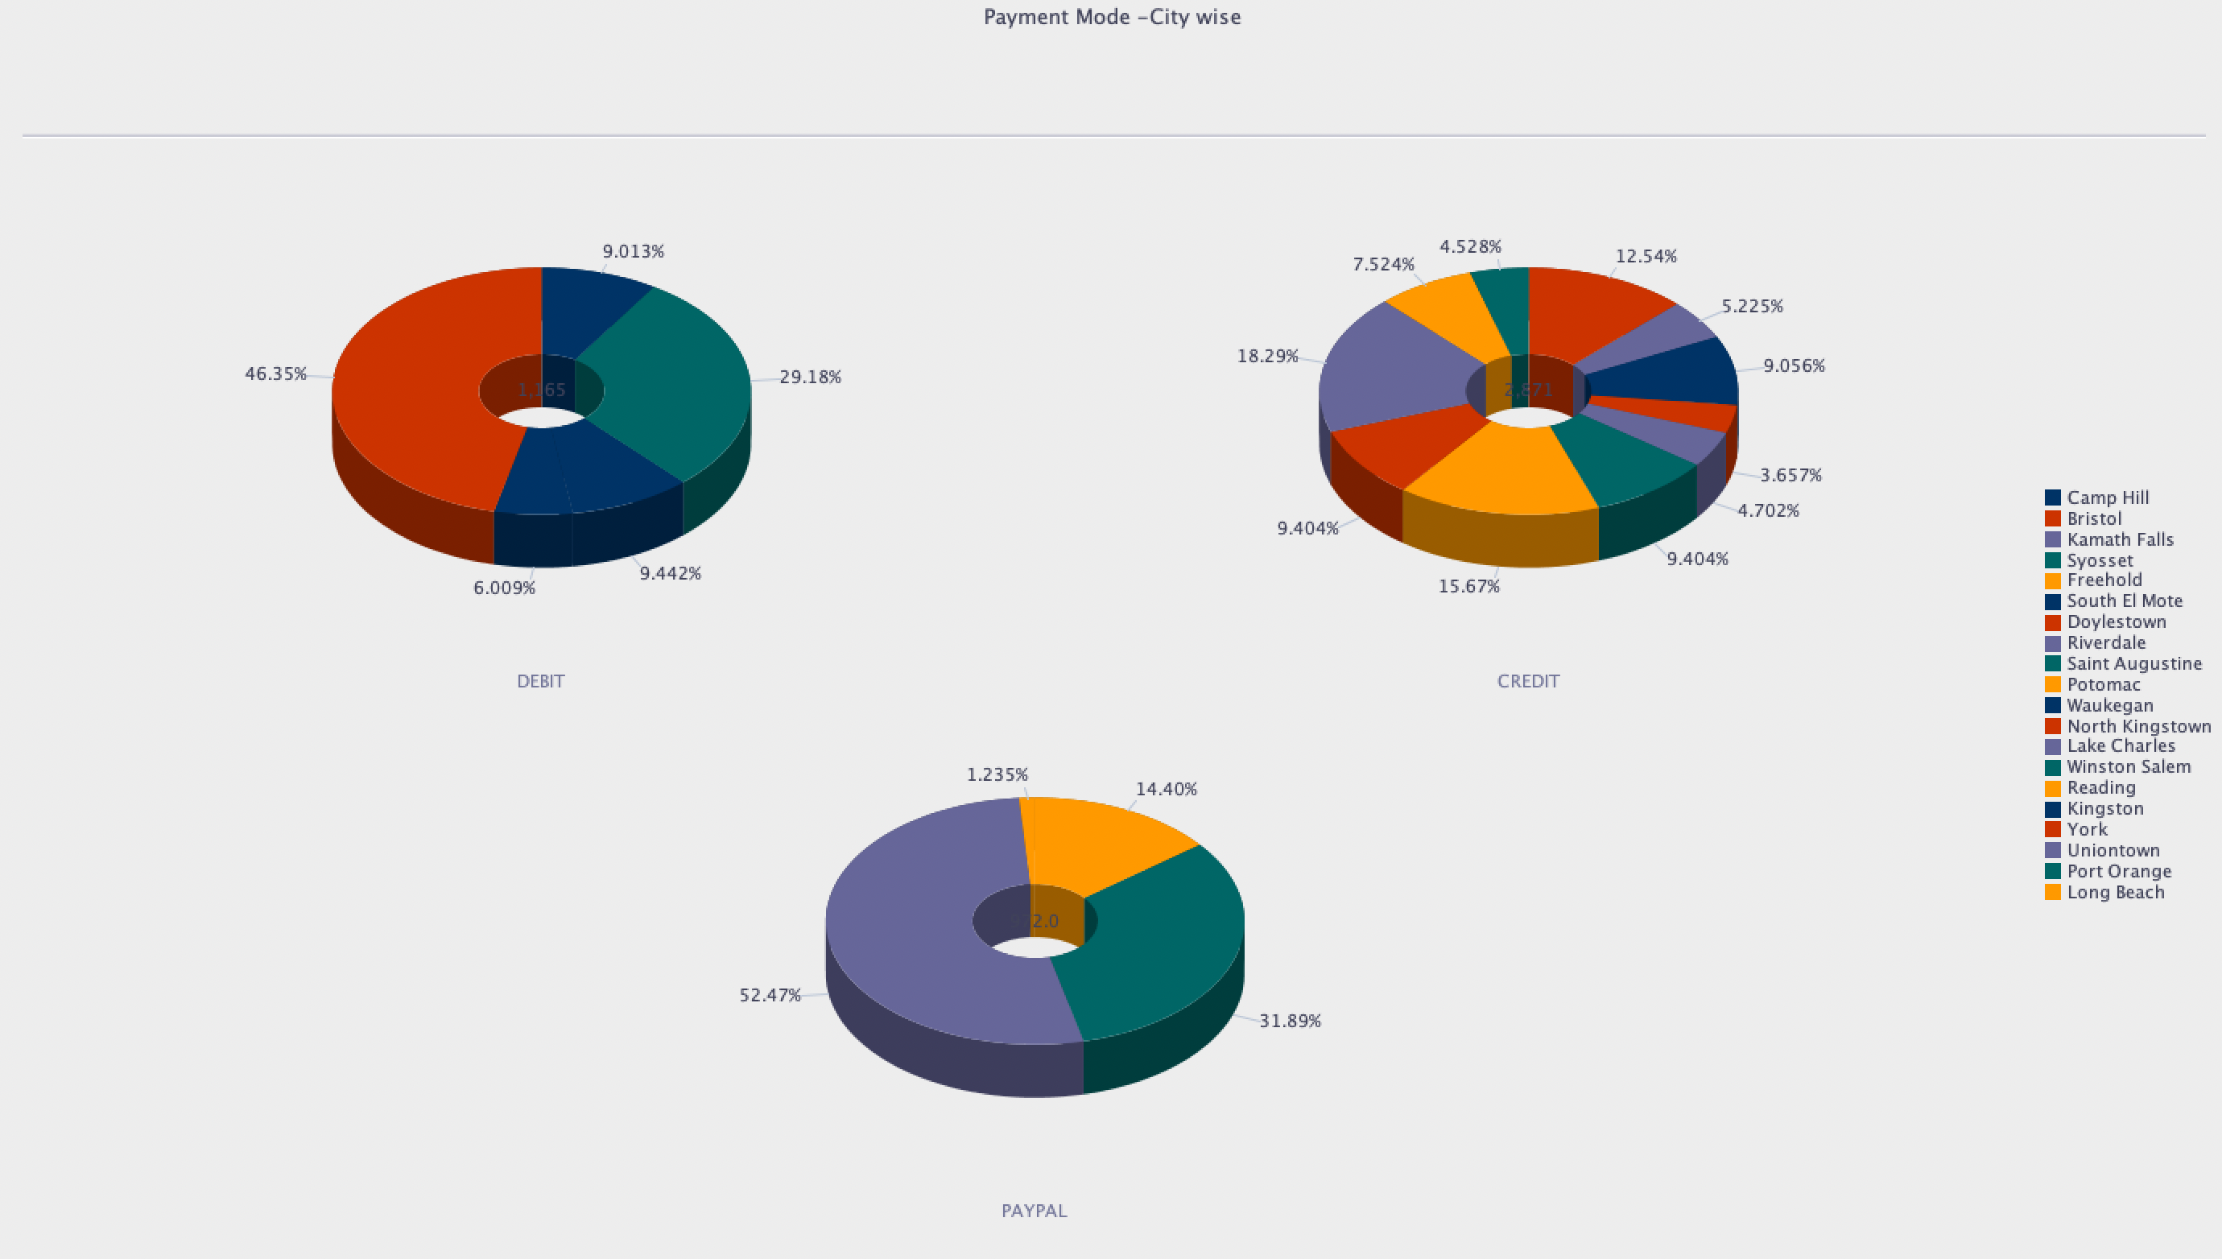
REPORTS

Slide 13
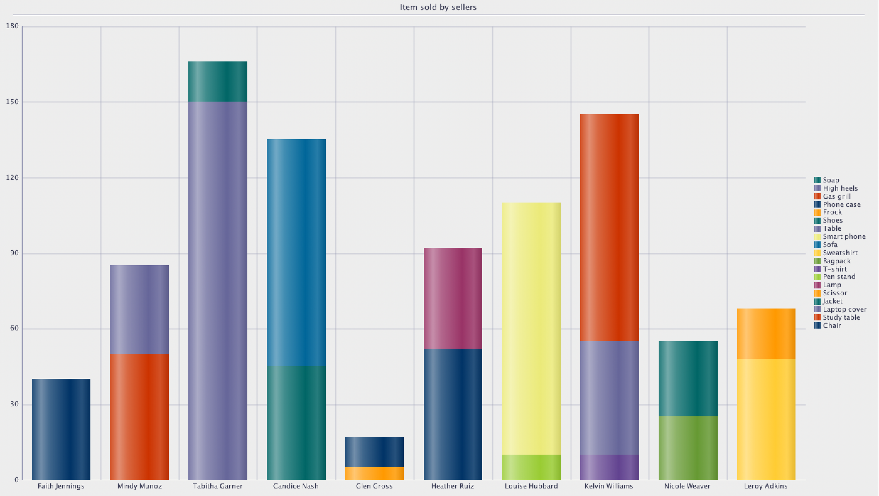
REPORTS

Slide 14
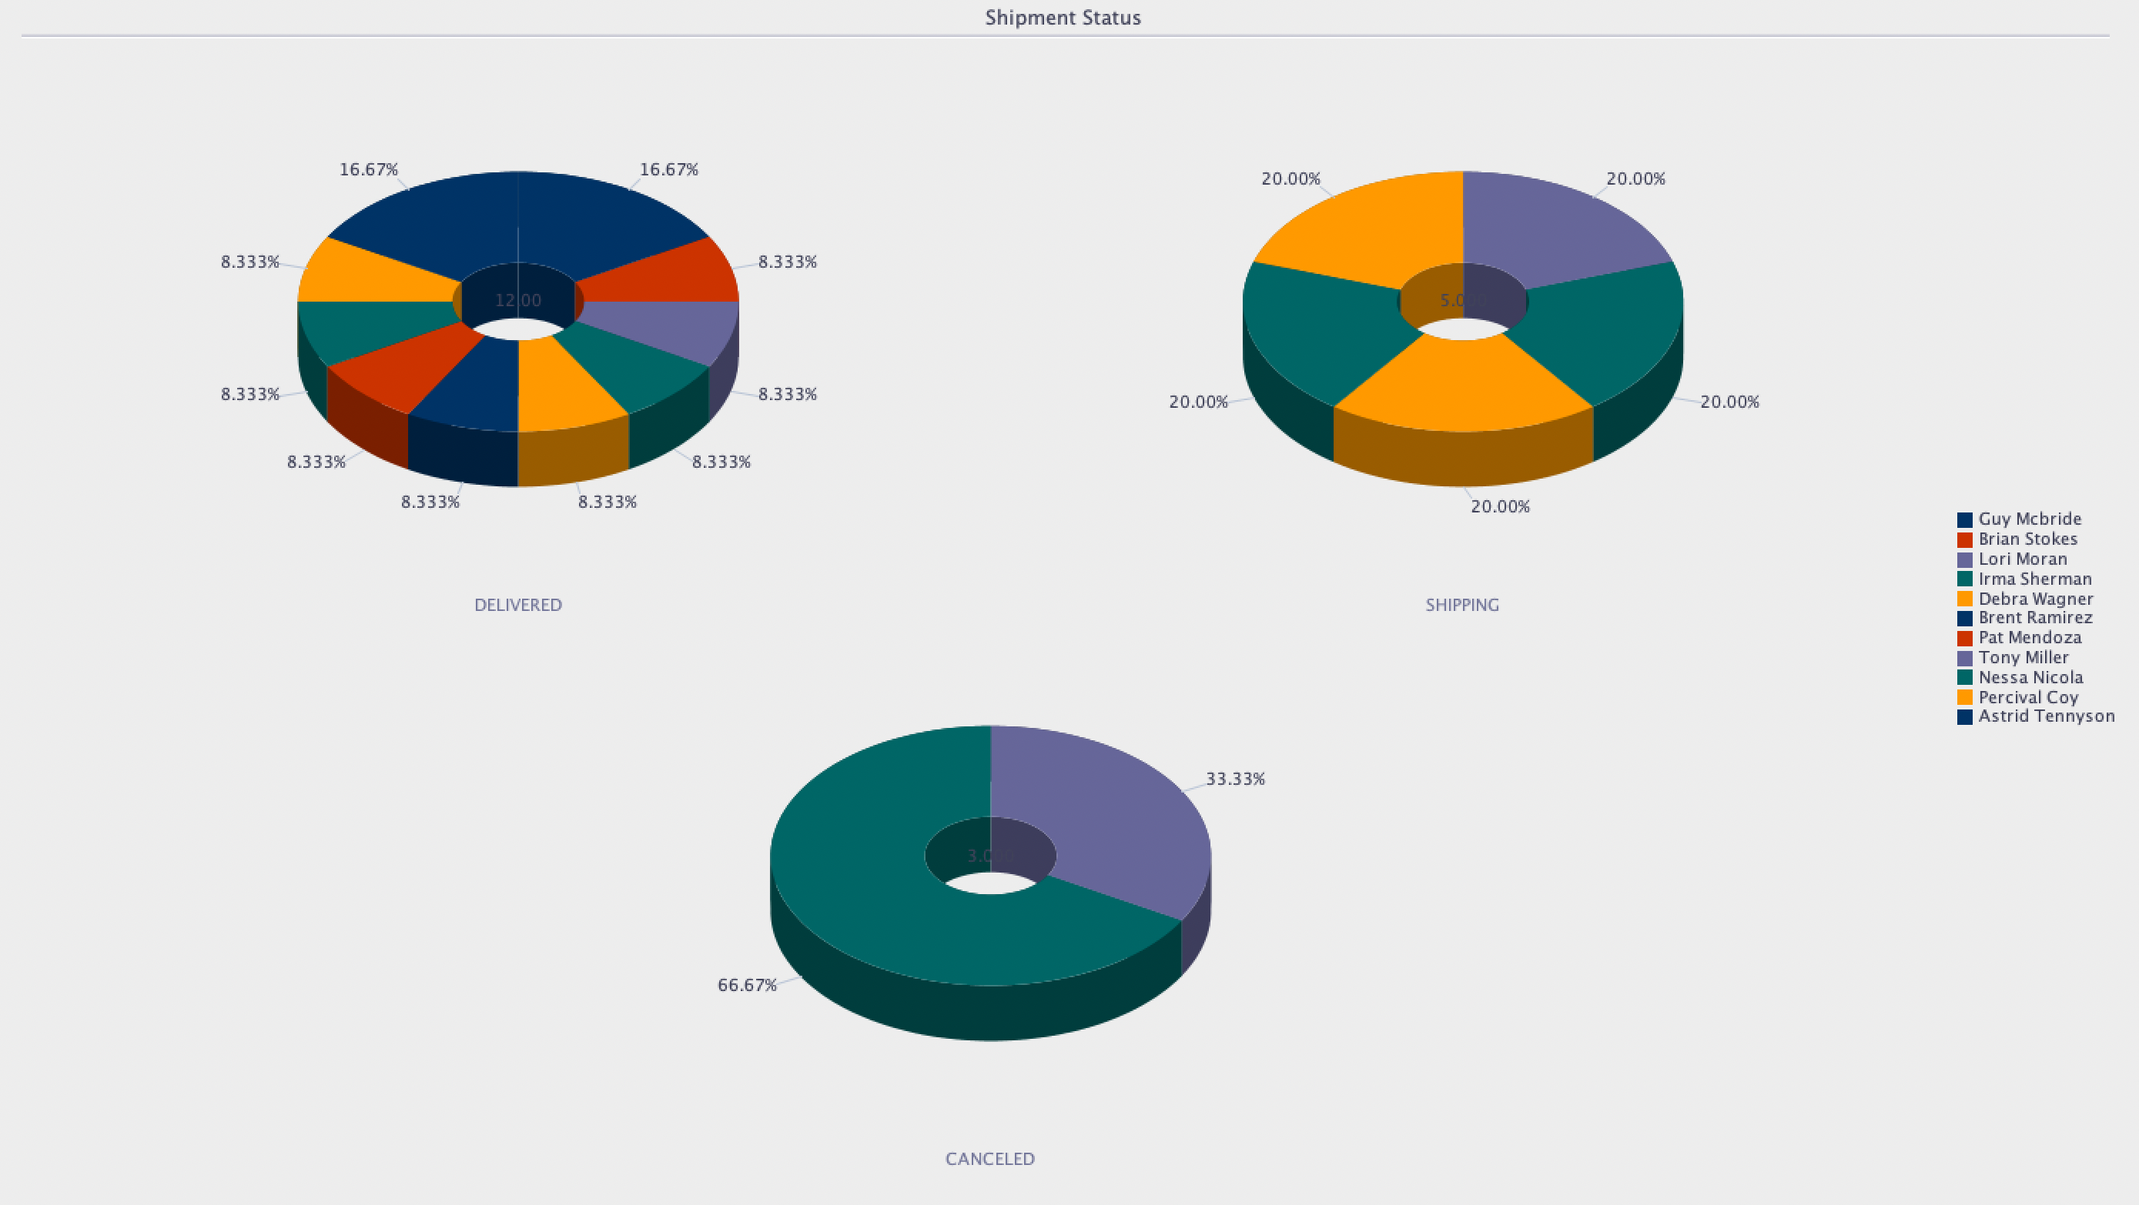
REPORTS

Slide 15
THANK YOU!

